Slide 1
Dynamic Universes

Slide 2
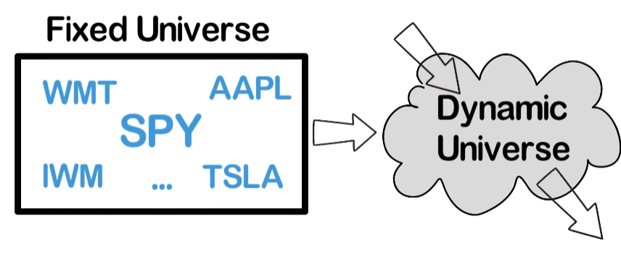

Slide 3
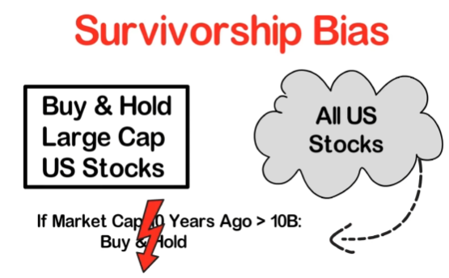
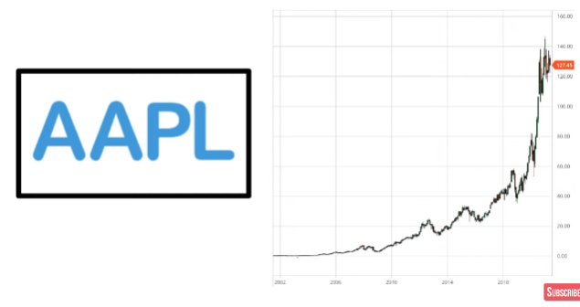
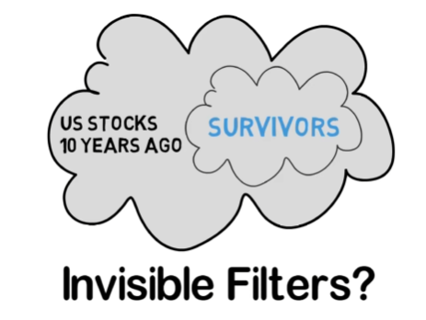
Is this bot working well just because you selected AAPL,
which was one of the best performing stock in the decade?

Slide 4
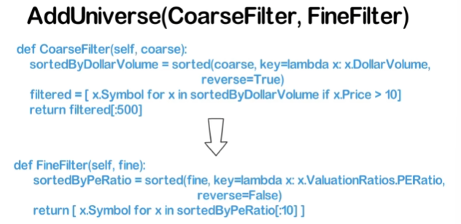
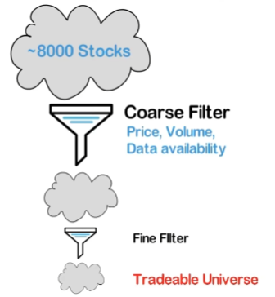
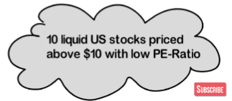

Universe Selection in QuantConnect

Slide 5
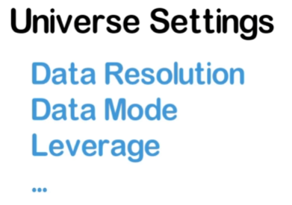
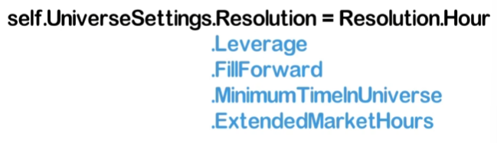
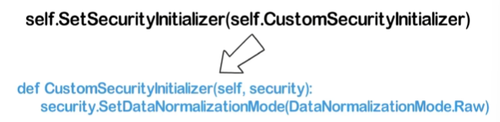
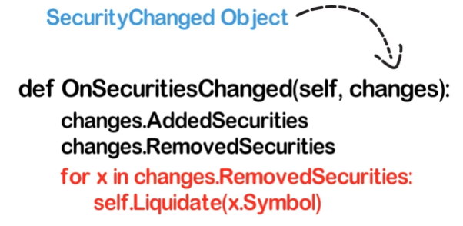

Slide 6
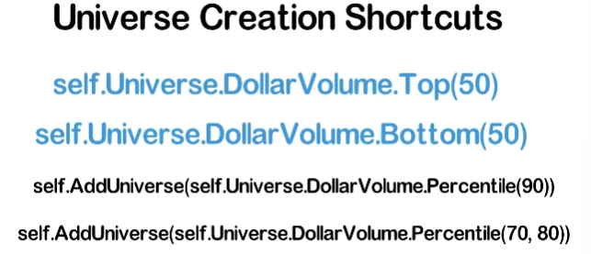

Slide 7
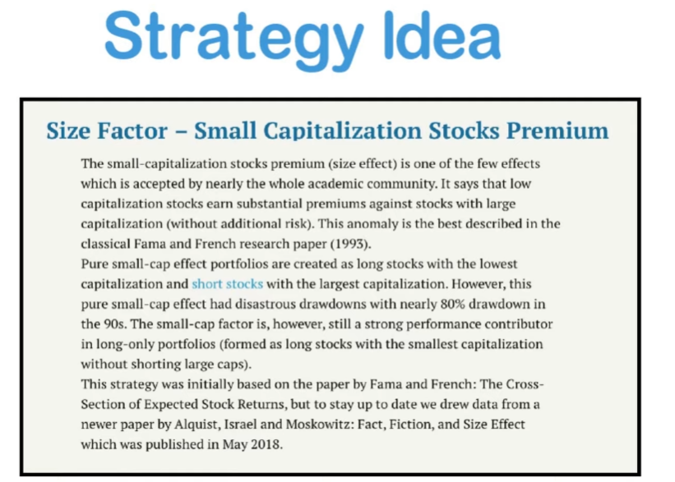


Slide 8
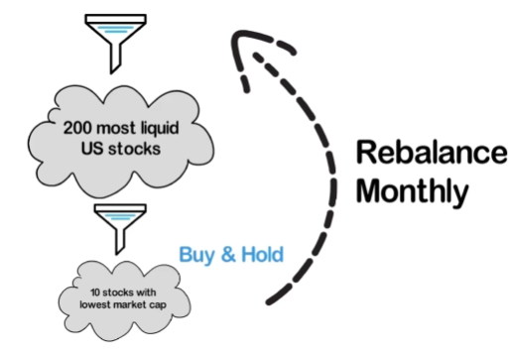

Slide 9
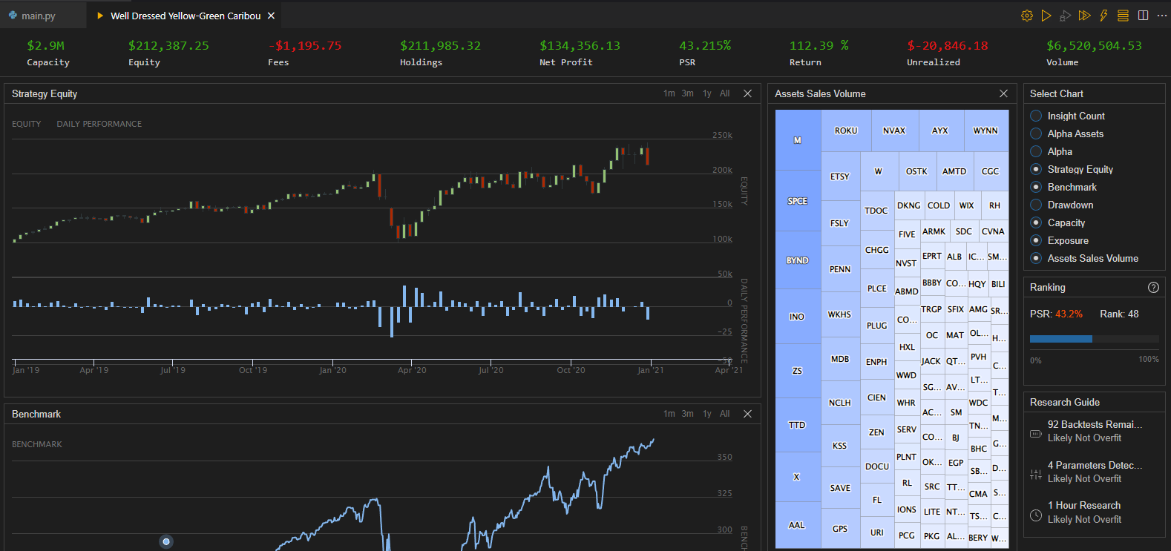

Slide 10
More advanced fundamental investing bot video: https://www.youtube.com/watch?v=rYHFGOZM7s8
(Quantpedia) Size Factor: https://quantpedia.com/strategies/small-capitalization-stocks-premium-anomaly/
QuantConnect fundamentals reference: https://www.quantconnect.com/datasets/morning-star-us-fundamentals
QuantConnect dynamic universe docs: https://www.quantconnect.com/docs/v2/writing-algorithms/universes/key-concepts?ref=v1

